Slide 1
Parallel Computing
Lab (3) Notes
Autumn 2024-25

Slide 2
Buffered Channels
Buffered channels are commonly used in scenarios where production of data and its consumption are not always synchronized but still require a controlled flow.

Slide 3
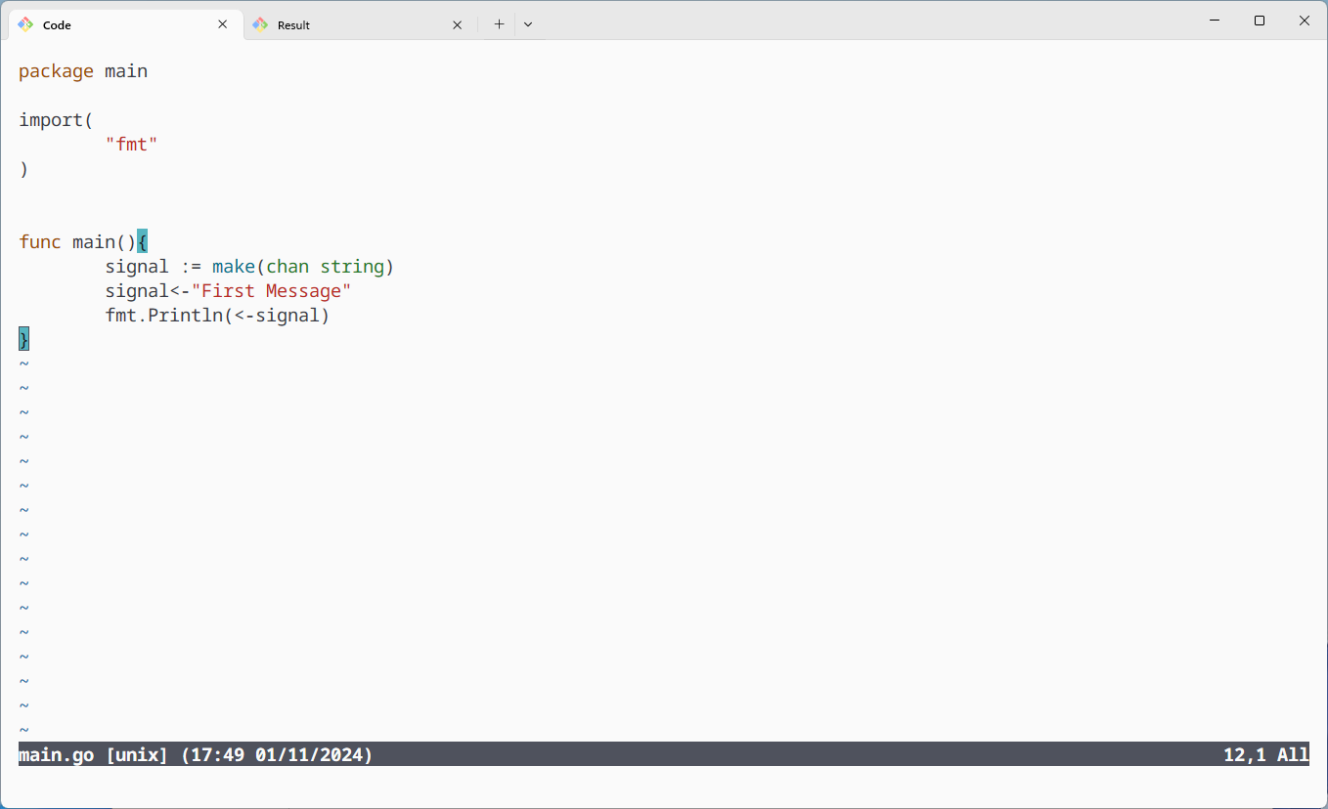
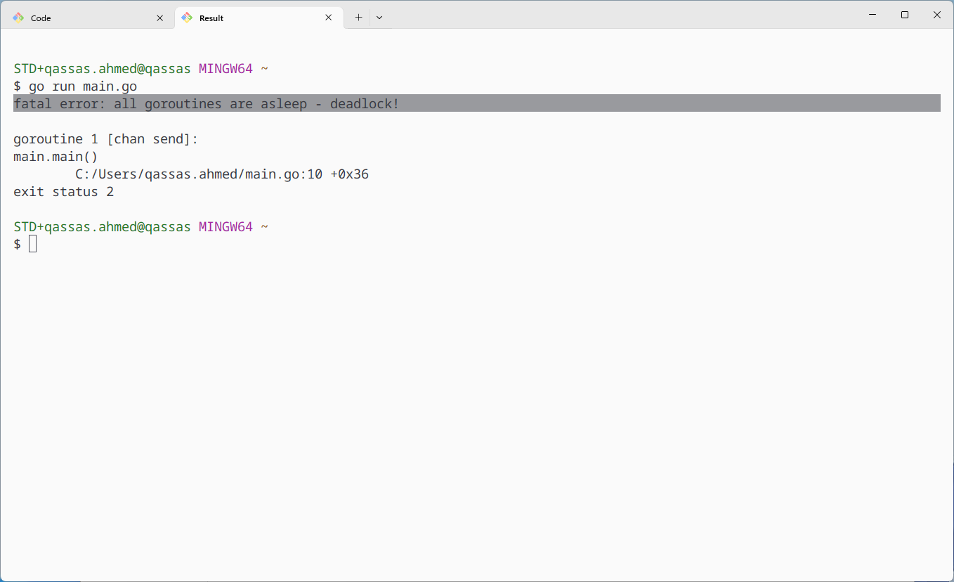
Deadlock problem

Slide 4
Buffered Channel

Slide 5
Deadlocks
Deadlocks in Go channels happen when goroutines are waiting on each other indefinitely, often due to incorrect handling of channels and synchronization.

Slide 6
Iterating Channels
In Go, you can iterate over a channel using the for range loop.
This is particularly useful for processing items as they come in, without worrying about when the sending finishes.

Slide 7
https://www.geeksforgeeks.org/time-time-unixnano-function-in-golang-with-examples/

Slide 8
https://pkg.go.dev/math/rand

Slide 9
Closing Channels
However, the channel must be closed to signal the end of iteration, or else the loop will continue indefinitely, waiting for more data.

Slide 12
Tip: Error handling
err = nil means that no error has occurred.
err != nil means that an error has occurred.
For secure random numbers (e.g., in cryptographic applications), use the crypto/rand package instead.
math/rand is not suitable for security purposes because it’s pseudo-random, meaning the sequence can be predicted if the seed is known.
https://go101.org/article/nil.html

Slide 13
Thank You

